Slide 1



Hardware and Software Fundamentals of Intelligent Computing Systems

Slide 2
Lecture 29: Model Parallelism I (Tensor Parallelism)
Notes:
单击此处添加文本

Slide 3
Limitation of DP
Tensor Parallel
Sequence Parallel
Notes:
单击此处添加文本

Slide 4
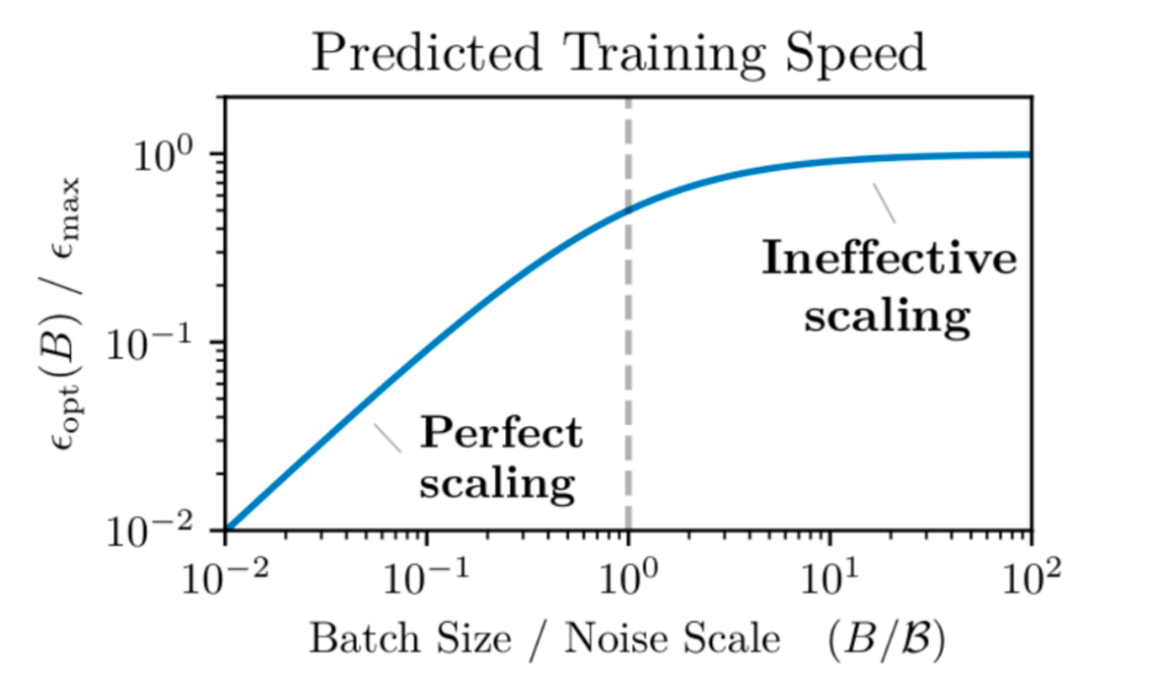
Issues remain with data parallel – compute scaling
With data parallel, #machines < batch size (and near this, comm overhead is high)
And there’s diminishing returns to batch sizes
Notes:
单击此处添加文本

Slide 5
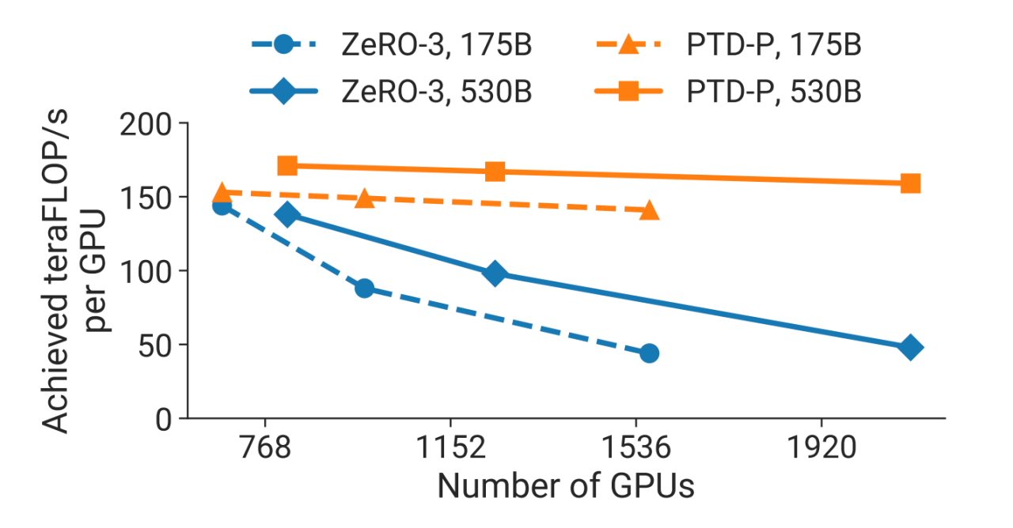
Issues remain with data parallel – models don’t fit
ZeRO-1 and ZeRO-2 don’t let you scale memory
ZeRO-3 is nice in principle, but can be slow and does not reduce activation memory
Activations ∝
seq_len × hidden_size ×
num_layers × global_batch_size
Out-of-memory (OOM) explosion !
Better ways to split up the model is needed…
Notes:
单击此处添加文本

Slide 6
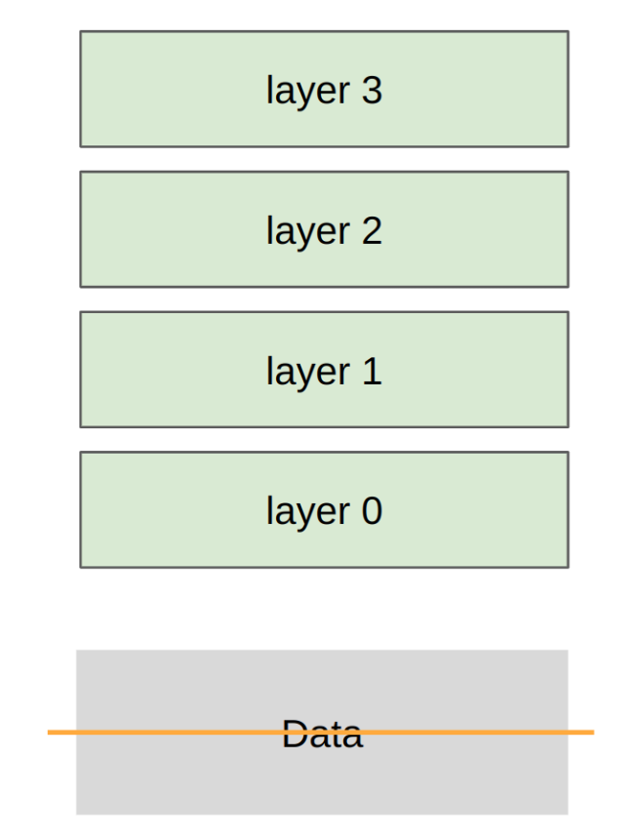
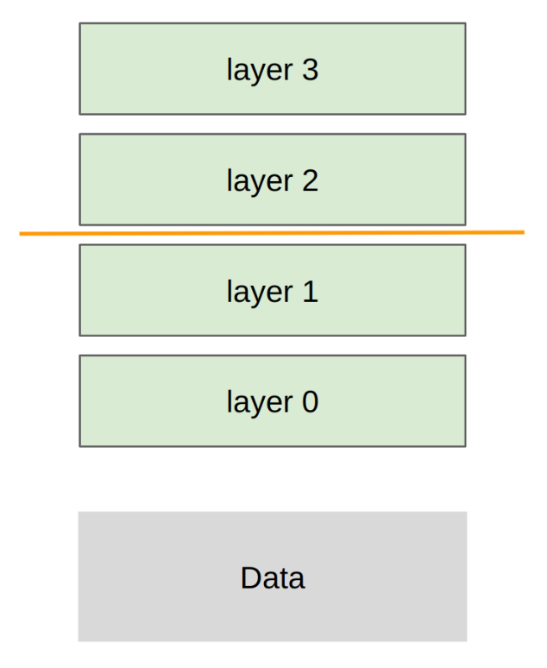
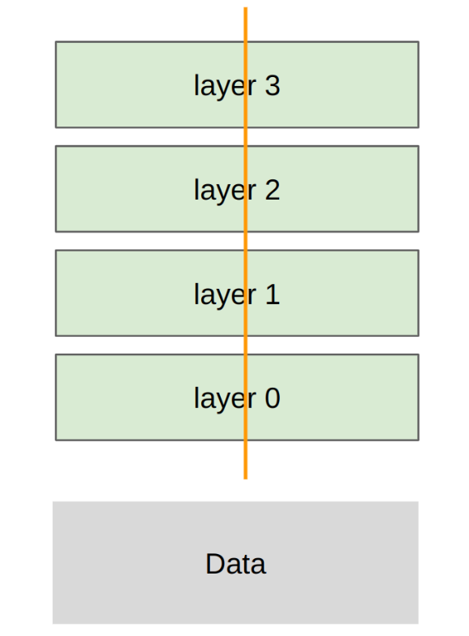
Model parallel along the different axes
Data Parallel
Pipeline Parallel
Tensor Parallel
Notes:
单击此处添加文本

Slide 7
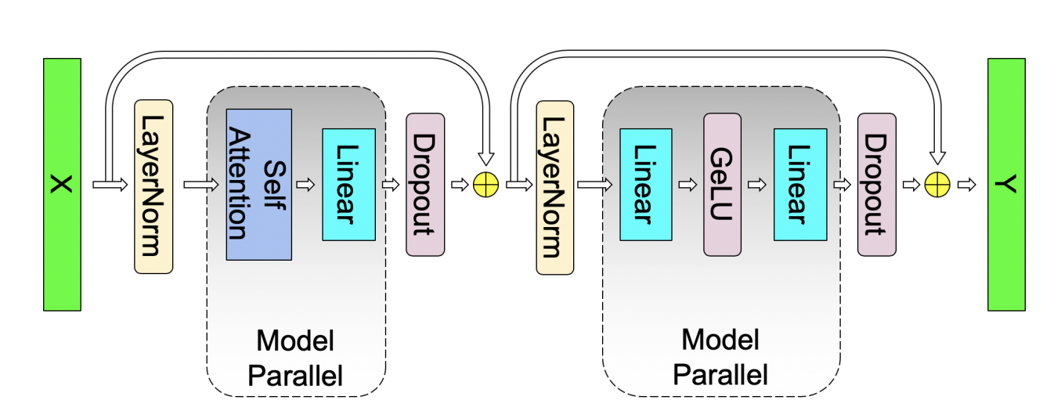
Tensor parallel – Basic Concept
The vast majority of LLM parameters reside in Linear Projections:
Attention: Q, K, V, and Output projections.
MLP: Up and Down projections.
These projections are General Matrix Multiplications (GEMM) (Y=XW)

Slide 8
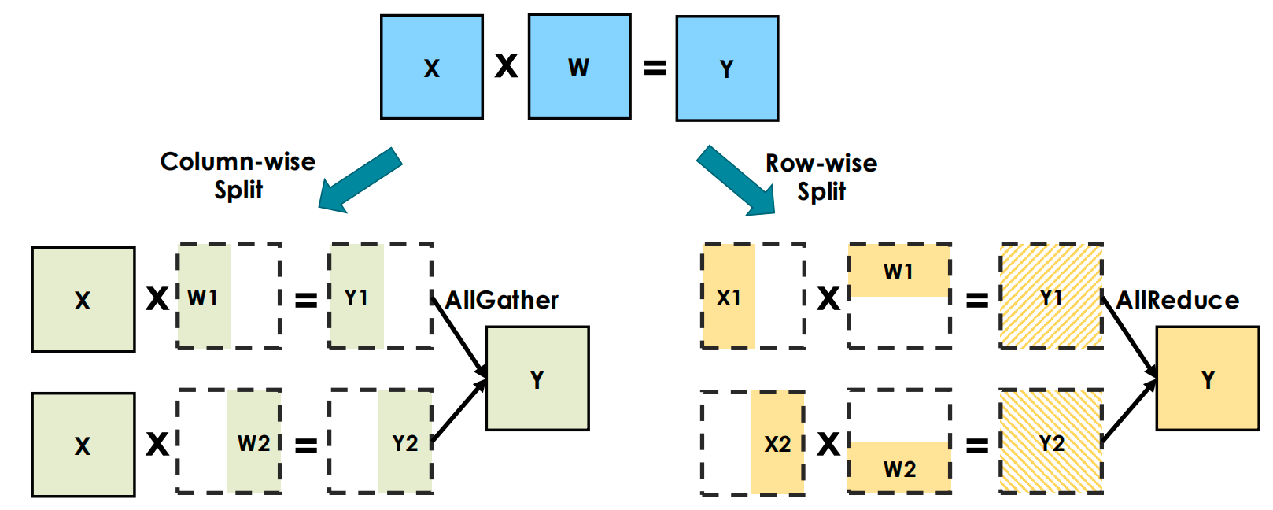
Tensor parallel – Basic Concept
Two ways to partitioning the GEMM to different GPUs：

Slide 9


Tensor parallel – Deconstructing the MLP Block
An MLP block consists of a linear expansion, a non-linear activation (GeLU), a linear projection back to hidden dimension and a dropout.
Mathematically,
Notes:
单击此处添加文本

Slide 10
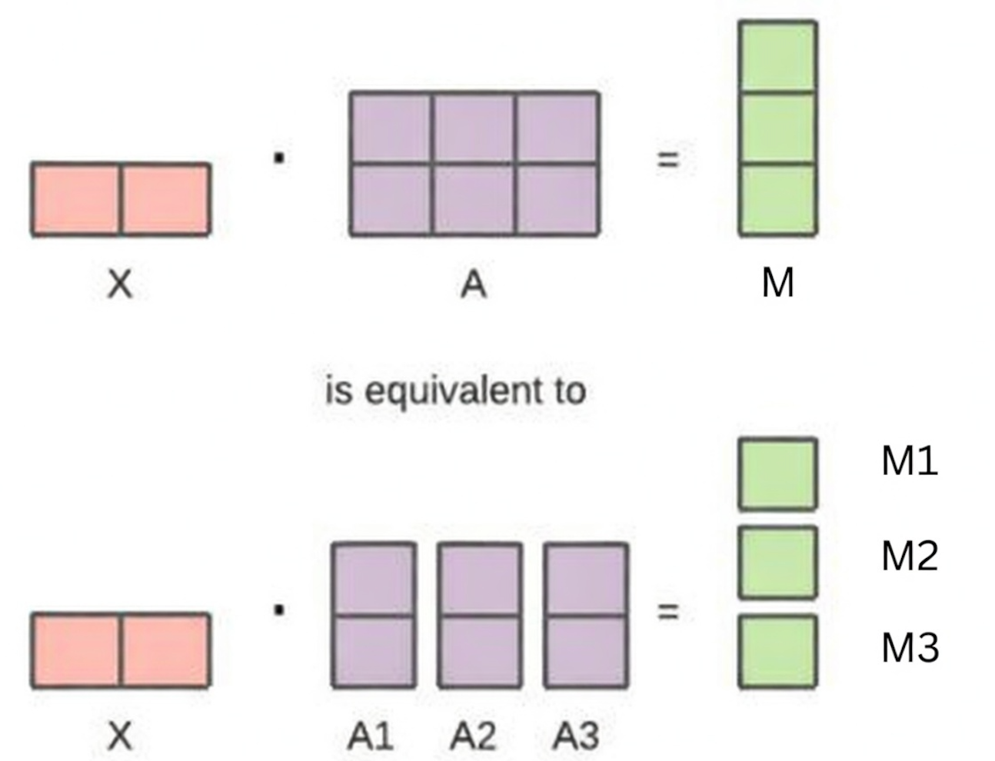

Tensor parallel – Deconstructing the MLP Block
Row-wise split of A: requires synchronization
Column-wise split of matrix A: the output can be fed into GeLU independently
Notes:
单击此处添加文本

Slide 11
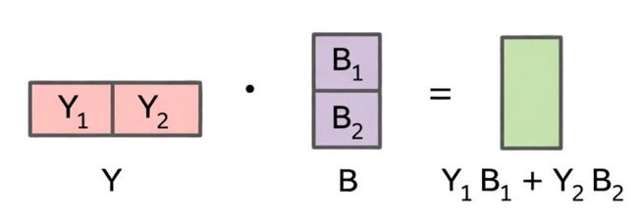
Tensor parallel – Deconstructing the MLP Block
Column-wise split of matrix A -> Column-wise split of Y
Column-wise split of Y + Row-wise split of B: block-wise matrix multiplication requires no synchronization
Notes:
单击此处添加文本

Slide 12
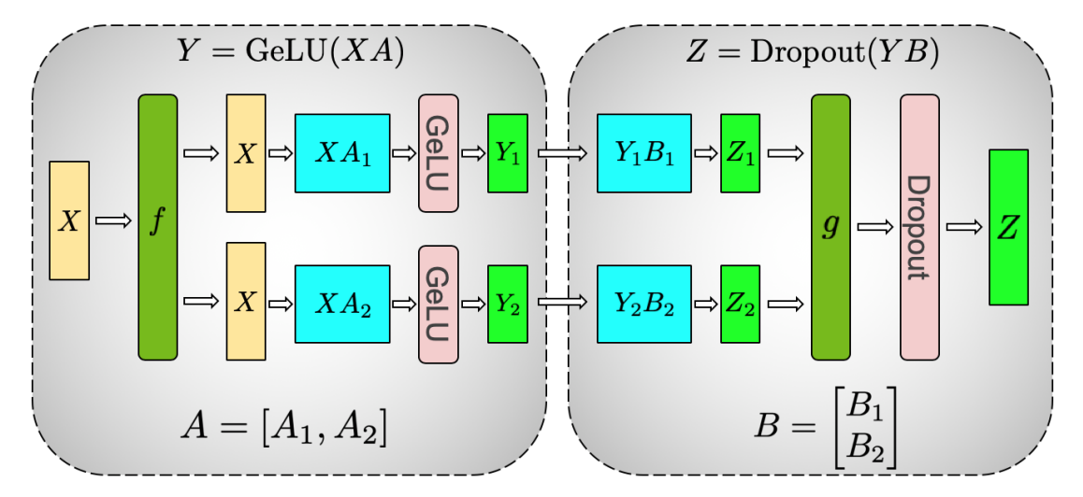
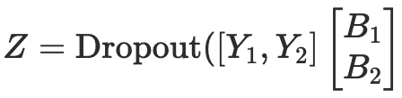
Tensor parallel – Deconstructing the MLP Block
Assign columns (A1, A2) and rows (B1, B2) to separate GPUs.
In the forward pass, f is the identity, and g is an all-reduce.
In the backward pass, f is an all-reduce, g is the identity.
MLP w.o. TP ===>
MLP w. TP ===>
Notes:
单击此处添加文本

Slide 13
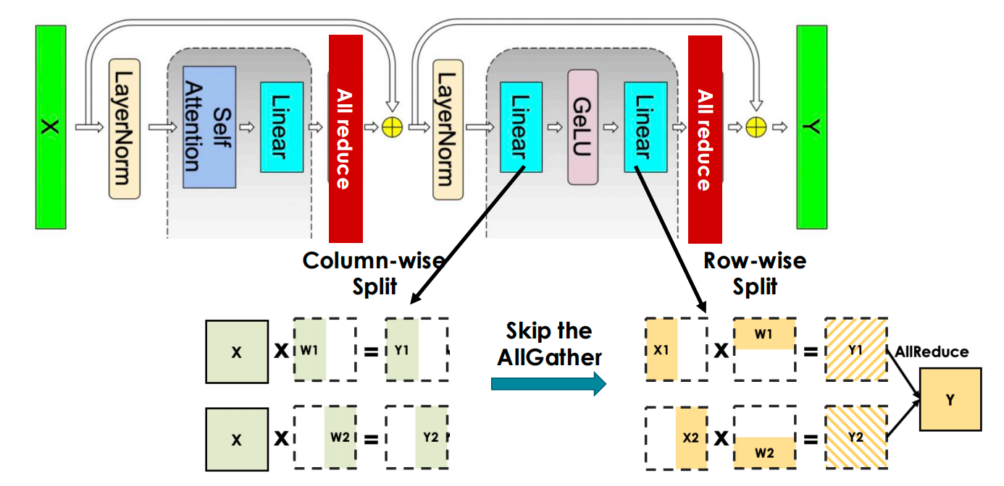
Tensor parallel – Tensor Parallelism for MLP
Interleaving split to minimize communication:
Notes:
单击此处添加文本

Slide 14
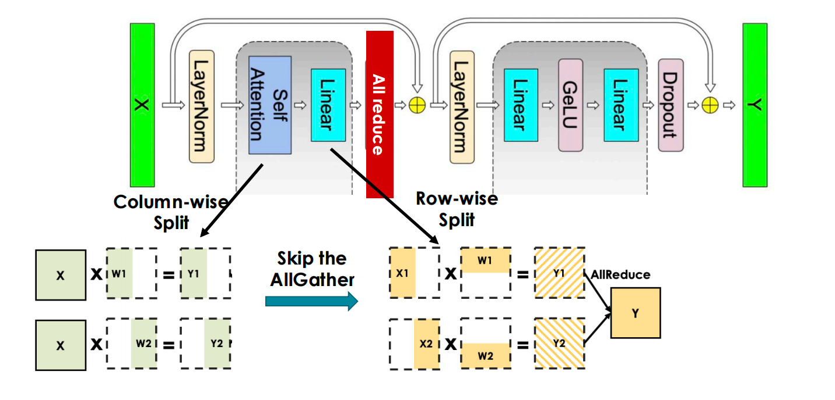
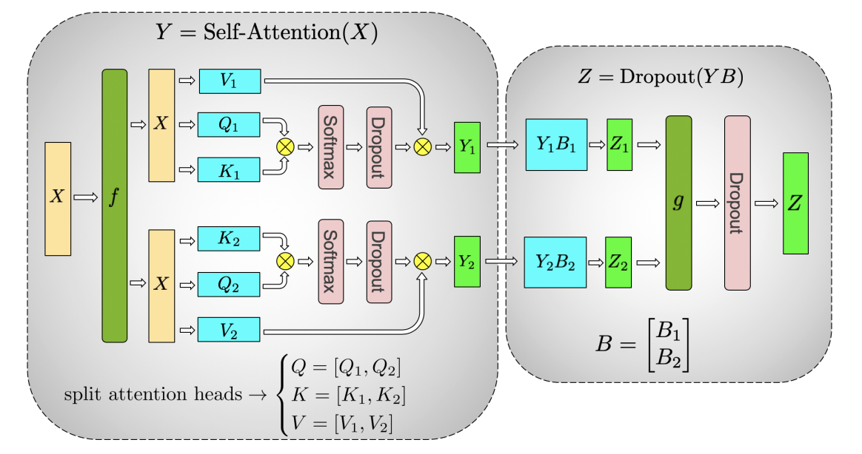
Tensor parallel – Tensor Parallelism for Attention
Interleaving split to minimize communication:
Notes:
单击此处添加文本

Slide 15
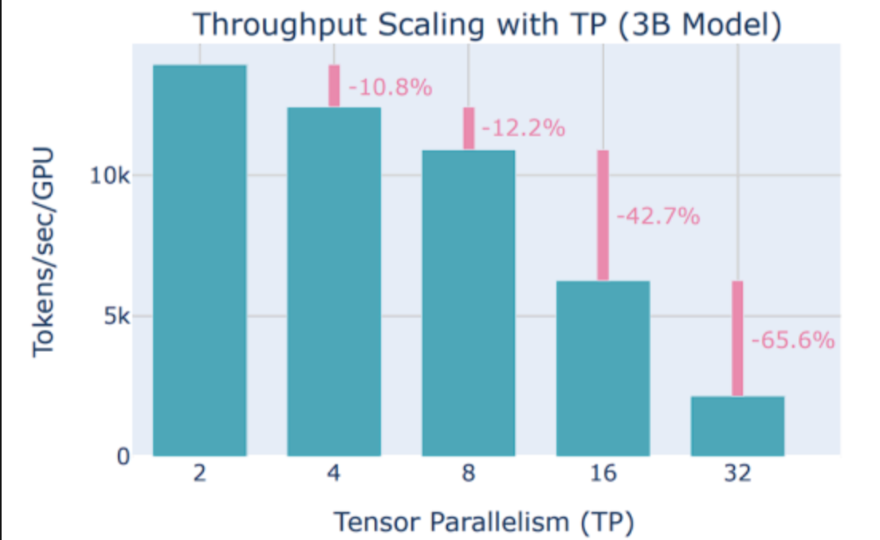
When to use TP?
On GPUs, tensor parallel within a node (up to 8 GPUs) due to high speed interconnects.
Notes:
单击此处添加文本

Slide 16
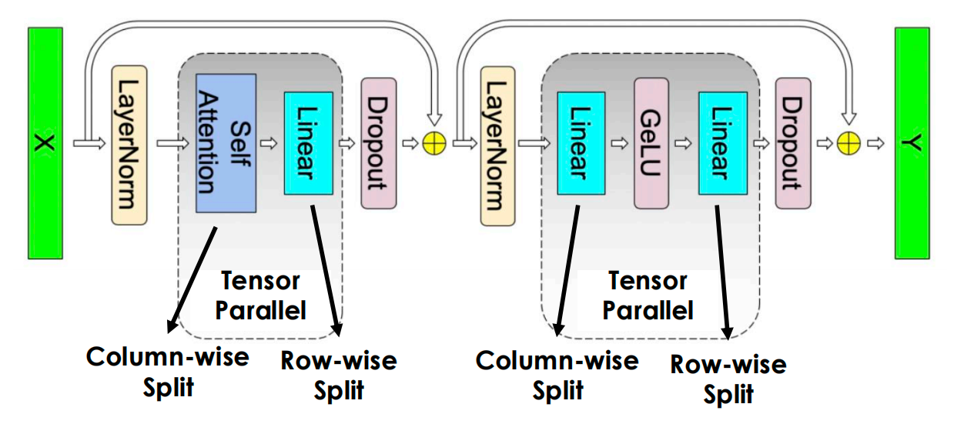
Limitation of TP
TP only splits GEMM
LayerNorm and DropOut are still replicated
Full activation memory overhead [batch_size*seq_len, hidden_dim] on each TP partition
Notes:
单击此处添加文本

Slide 17
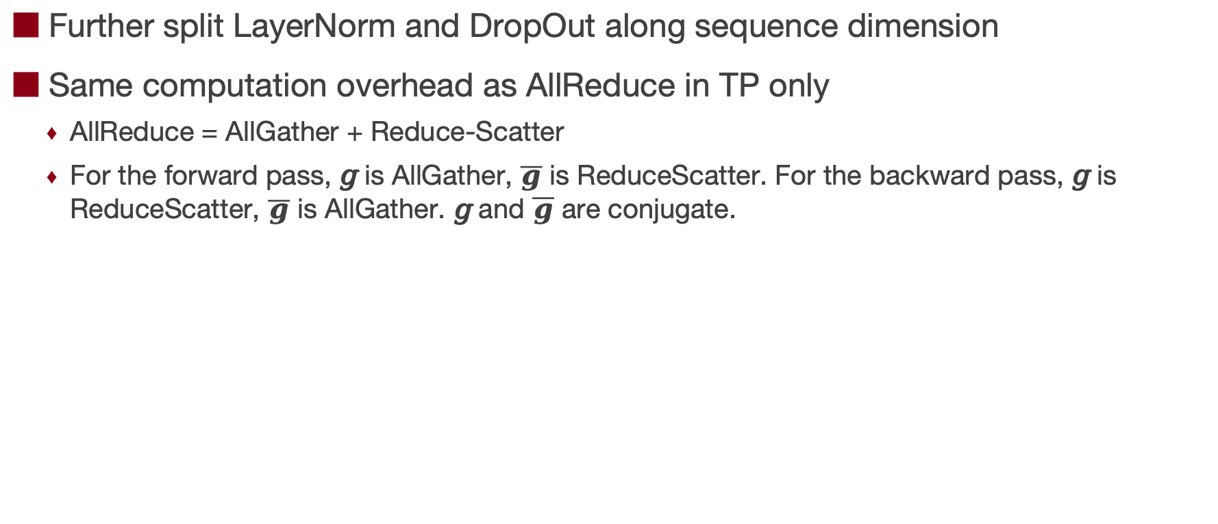
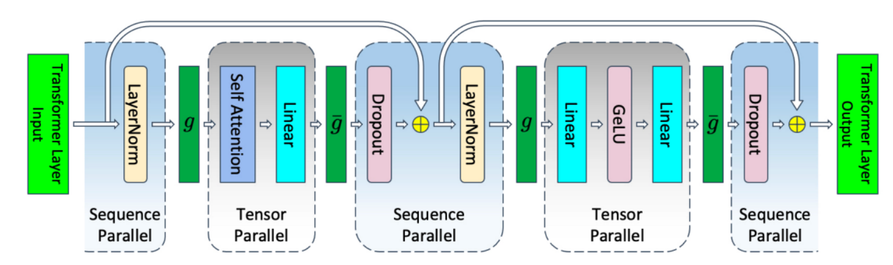
Tensor parallel – Sequence Parallel [MLSys’23]
Notes:
单击此处添加文本

Slide 18

The Solution: FlagOS, a Unified AI Software Stack

Slide 19








https://space.bilibili.com/3546791834290849
https://github.com/flagos-ai
https://www.zhihu.com/people/95-22-20-18/posts
https://flagos.io/Home

Slide 20

Thanks for your time！

